Slide 1

Social Media Analytics
Sentiment Analysis of user comments on F1 races

Slide 2
Final Project
DS5110 – Introduction to Data Management and Processing
Dr. Fatema Nafa
f.nafa@northeastern.edu
Team 7
Sanjiv Motilal Choudhari
M.S., Data Science
(Batch of 2025)
motilalchoudhari.s@northeastern.edu
Shivram Nekkanti
M.S., Data Science
(Batch of 2026)
nekkanti.sh@northeastern.edu

Slide 3
Introduction
F1 - Global motorsports event - Millions of fans engaging actively in social media
The project explores fan sentiments across 20 races in the 2024 season by analyzing YouTube comments to uncover audience perceptions about racers, teams, and race events.

Slide 4
Introduction
Objective - Analyze fan sentiments, Gauge Perceptions and Classify fan emotions.
Goal - Provide insights on popularity, trends and fan engagement.
Scope – Data Collection, Preprocessing, Sentiment Analysis and Visualization

Slide 5
Sentiment Analysis Projects [1][3][5]

Slide 6
Literature Review
Sports Sentiment Analysis: Previous studies have applied NLP to analyze fan sentiments from social media, showing that fan emotions are strongly tied to event outcomes and racer performance. [4]
Emotion Analysis in Sports: NRC Lexicon and similar tools are widely used to classify fan sentiments, emphasizing the importance of real-time emotional shifts during races [5]

Slide 7
Literature Review
Relation of our Project to Previous Work
Extends existing methodologies by focusing on F1 races, a relatively underexplored domain in fan sentiment analysis.
Enhances emotion tracking by integrating visualizations to show trends over time for drivers and teams.

Slide 8
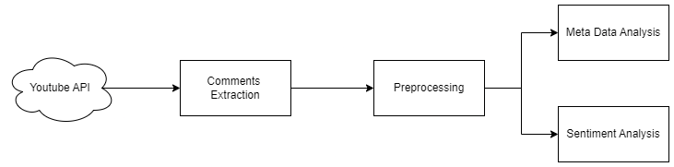
Methodology
Data Collection – 20 races, 5k comment each
Preprocessing – Cleaning, filtering and labeling
Sentiment Analysis – NRC Lexicon and VADER
Visualizations – Matplotlib and seaborn
Notes:
Data structures used – list for scraped comments and filkteringg
Dictionary for sentiment analysis results
Pandas dataframe for storing and manipulating data
Plot objects in seaborn and matplotlib

Slide 9

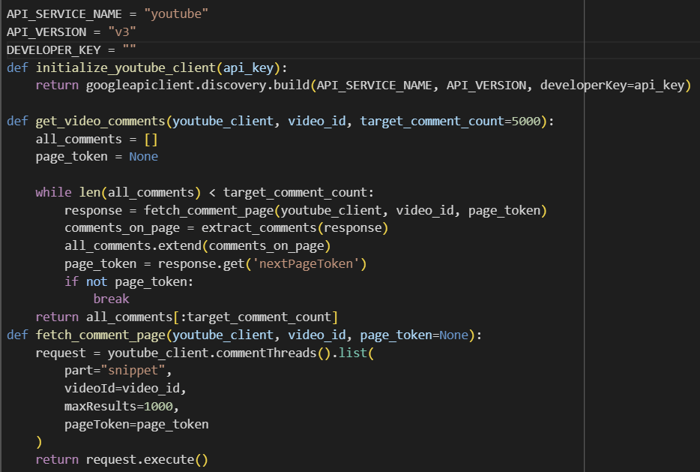
Methodology
To extract comments for this project, we used the YouTube Data API, which allows us to access and retrieve user comments from videos related to Formula 1 races.
API Key Setup: We first obtained an API key from YouTube to authenticate our requests and access the platform's data.
Querying Videos: We identified relevant videos based on race highlights, post-race discussions, and driver-related content, using video IDs to target specific Formula 1 topics.
Comment Retrieval: Using the API’s comment threads endpoint, we retrieved comments, ensuring to handle pagination when dealing with large datasets, as YouTube only returns a limited number of comments per request.
Data Processing: Once comments were extracted, we cleaned the data by removing spam, irrelevant information, and any unnecessary formatting, preparing it for sentiment and emotion analysis.

Slide 10
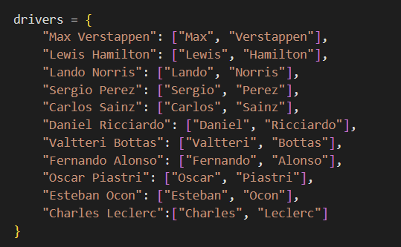
Handling Driver Name Variations
Problem: Comments may mention only the first name, last name, or a nickname of a driver, making it difficult to attribute sentiments to the correct driver.
Created a mapping of driver names with variations (first name, last name, and possible nicknames).
Implemented code to check if any of the variations (e.g., "Max", "Verstappen") appeared in the comments.
Allowed flexibility for both first or last names to match comments accurately.

Slide 11
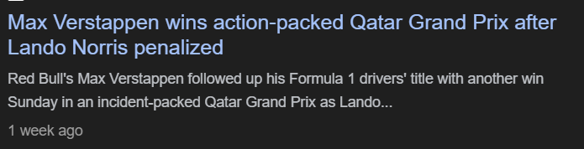
Multilabeling Sentiment Issue
Problem: A single comment can contain multiple drivers with different sentiments associated with each.
Applied driver-specific sentiment analysis by identifying each driver mentioned in the comment and associating individual emotions with them..
Used a fine-tuned sentiment model to detect emotions like joy, anger, and disappointment.
Applied a custom method to check each driver in the comment, match with name variations, and assign the correct sentiment/emotion based on the comment context.

Slide 12
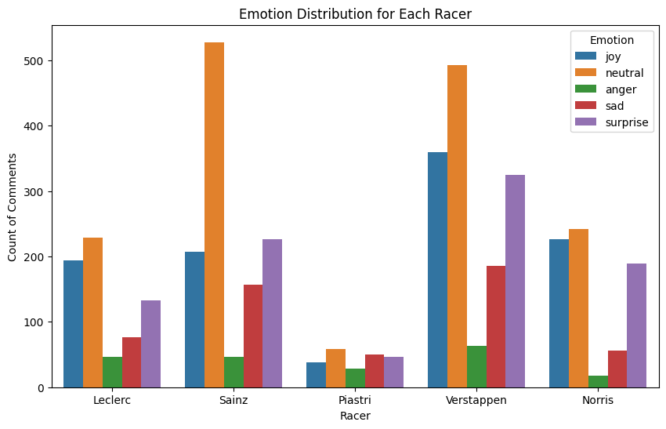
Analysis and Results
Bar plot for the sentiment distribution for racers

Slide 13
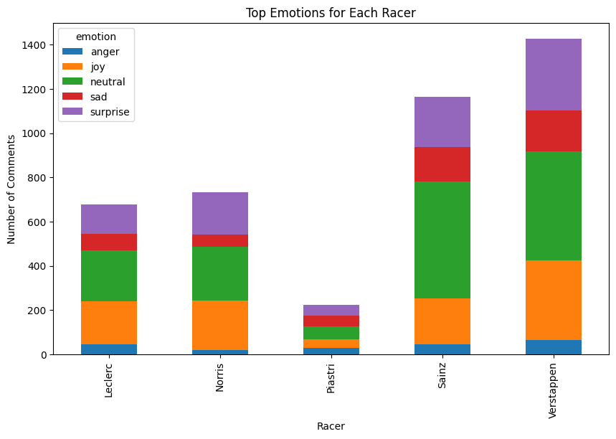
Stacked Bar plot for the sentiment distribution among racers

Slide 14
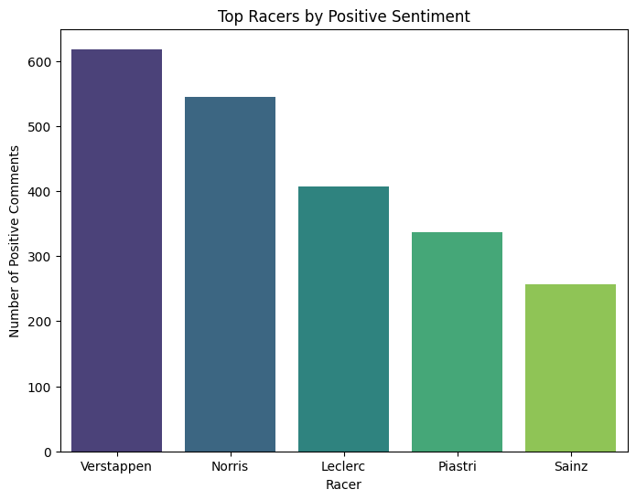
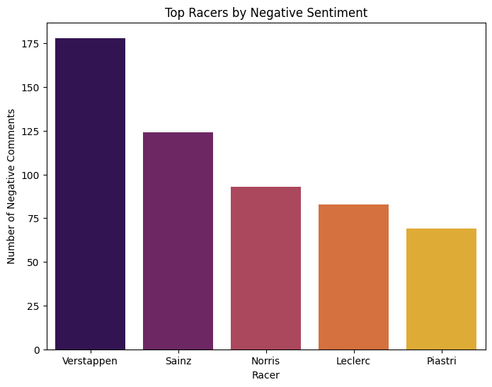
Top Racers by positive and negative sentiments on the F1 Grid

Slide 15
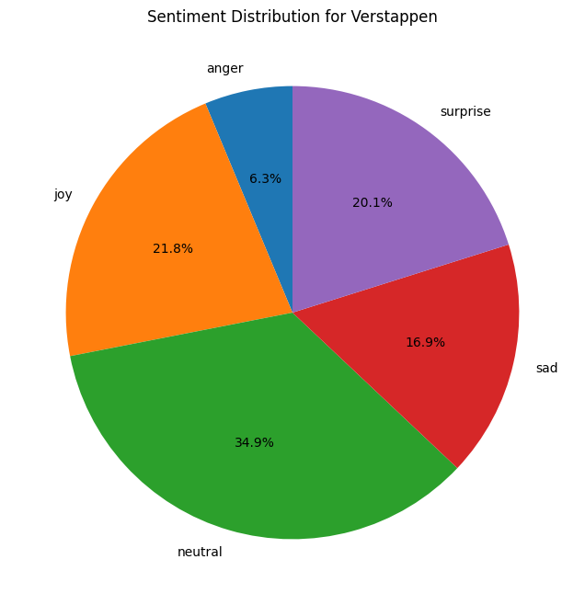
Pie Chart showing sentiment distribution for a racer

Slide 16
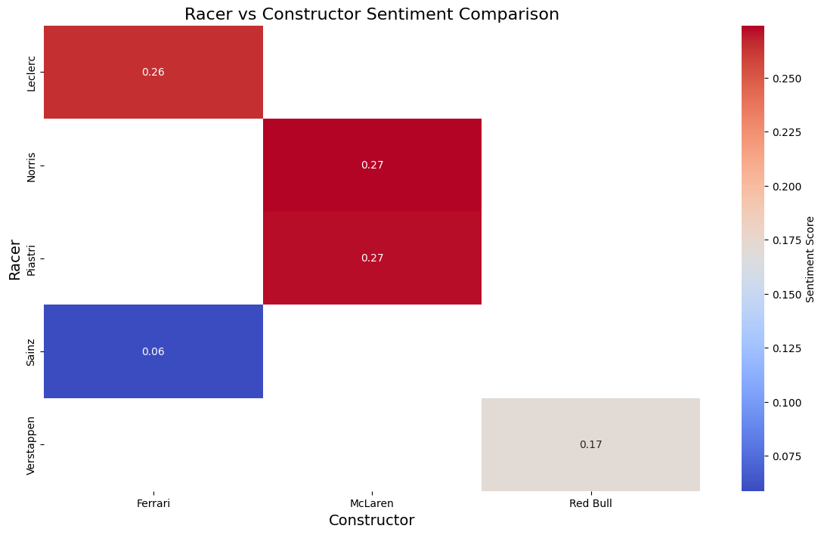
Heatmap for sentiment scores for top 5 racers
Warm color – better reception by fans
Cool color – negative perception

Slide 17
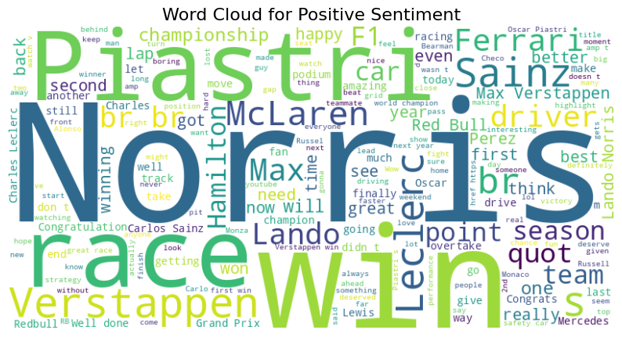
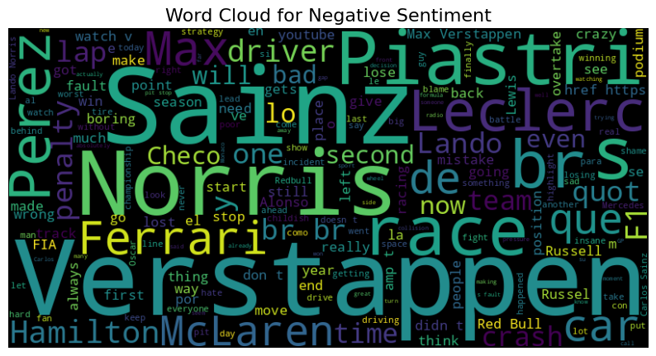

Slide 18
Key Findings
Joy and Surprise were strongly correlated with top-performing teams and popular racers – Verstappen, Norris, McLaren
Anger strongly correlated with race incidents and poorly performing teams or racers – Perez, Stroll, Ferrari
Comments with high emotional intensity (Surprise) received significantly more likes
Races with unexpected outcomes and dramatic incidents saw higher volume of comments and likes emphasizing event driven nature for fan incidents

Slide 19
How are these findings helpful
Marketing and Sponsorship
Performance Analysis
Event & Brand Management
Regional Targeted Marketing
Strategize for future races

Slide 20
Limitations
Data Scope (YouTube)
Data Bias (not considerate of external factors)
Sentiment Granularity (Sarcasm)
Sample Bias (F1 season 2024)
Language limitation
Notes:
Lacxk of granularity

Slide 21
Future work
Incorporate Multilingual data
Incorporate more social media platforms
Enhance the analysis (BERT, GPT) to improve accuracy of sentiment classification
Long term trends (beyond a season)

Slide 22
Conclusion
The project successfully analyzed Formula 1 fan sentiments, revealing emotional trends like joy, anger, and sadness tied to racer performances and team dynamics.
Teams and sponsors can leverage sentiment insights to enhance fan engagement, tailor strategies, and address audience concerns effectively.
The analysis highlights the importance of real-time sentiment tracking and offers a foundation for expanding to multilingual, multi-platform data for broader audience insights.

Slide 23
References
[1] Mahboob, Khalid & Ali, Fayyaz & Nizami, Hafsa. (2019). Sentiment Analysis of RSS Feeds on Sports News – A Case Study. International Journal of Information Technology and Computer Science. 11. 19-29. 10.5815/ijitcs.2019.12.02.
[2] Patel, R., & Passi, K. (2020). Sentiment Analysis on Twitter Data of World Cup Soccer Tournament Using Machine Learning. IoT, 1(2), 218-239. https://doi.org/10.3390/iot1020014
[3] Wunderlich, F., & Memmert, D. (2020). Innovative Approaches in Sports Science—Lexicon-Based Sentiment Analysis as a Tool to Analyze Sports-Related Twitter Communication. Applied Sciences, 10(2), 431. https://doi.org/10.3390/app10020431

Slide 24
References
[4] Chung, J., & Zeng, Y. (2021) Sentiment analysis and audience engagement in esports: A comparative study using social media data. Journal of Sports Analytics, 7(3), 183-198. DOI: 10.3233/JSA-200433
[5] Wang, S., & Liu, J. (2019) Emotion-based Sentiment Analysis Using NRC Lexicon: Applications in Analyzing Fan Reactions in Major Sports Events. IEEE Transactions on Affective Computing, 10(2), 205-215. DOI: 10.1109/TAFFC.2019.2954231

Slide 25
Thank You

